Slide 1
PHOTOGRAPHERS
You Are Invited
To Enter a Photography Exhibit
Hosted by
Harbour City Photography Club
Nanaimo, BC

Slide 2
PHOTO SALON 2020
June 1 – June 12
Daily 10am – 3pm
Friday, June 5 10am – 7pm

Slide 3
Photo Salon Is
A FORUM for photo competitions, recognized internationally
A JURIED VENUE to display outstanding work of local photographers
A SHOWCASE to promote the appreciation of photography in the wider community

Slide 4
Photo Salon Is
AN EXHIBIT open to club and non-club members from Victoria to Campbell River
AN OPPORTUNITY to sell images with no commission
AN ANNUAL EVENT sponsored by the Harbour City Photography Club in Nanaimo

Slide 5
The Venue
The View Gallery
Vancouver Island University, Nanaimo
Building 330
FREE PARKING, Lot G
with
Photo Salon 2020 Permit
Notes:
The cost of parking at VIU has been a deterrent in the past, resulting in fewer attendees than desirable.

Slide 6
Three Phases
Phase 1: Digital Entries
Phase 2. Selection & Printing
Phase 3. Adjudication and Showcase
Notes:
FULL DETAILS available on the club website: www.hcpclub.ca

Slide 7
Phase One – Digital Entries
Enter up to 3 images
Entry fee is $10 per image
Digital images must be sized to 1050 pixels vertical and 1400 pixels horizontal maximum, regardless of orientation
email: photosalon2020@hcpclub.ca

Slide 8
Along With Your Image, Include
  your name
  title of the image
  selling price (if applicable)
  contact information
  category to which it belongs

Slide 9
CATEGORIES
Landscape
  This genre is broad and showcases all aspects of
  the beauty of the earth.
Street
  The focus is on a person or people going about their daily lives.
Notes:
Nature: Landscapes, seascapes, wildlife, stars, weather, botany, aquatic species. Incidental appearances of man-made objects do not disqualify from this category.
Portraiture: One person or a small group in context, candid or studio shots
Open: no subject restrictions; portraits and nature image are acceptable

Slide 10
CATEGORIES
Macro/Closeup
These images capture details often overlooked in our day-to-day activities.
Open
  This category is for photographs that do not belong in any of the above.
Notes:
Nature: Landscapes, seascapes, wildlife, stars, weather, botany, aquatic species. Incidental appearances of man-made objects do not disqualify from this category.
Portraiture: One person or a small group in context, candid or studio shots
Open: no subject restrictions; portraits and nature image are acceptable

Slide 11
Phase One Timeline
September
Invitations are sent to photographers and clubs
October 1 – February 15
Photographers submit their digital images
December 31
Names are entered for our early-bird draw
Notes:
Details on our website

Slide 12
Entry Fees
Entries are official when fees are paid
Payable to HCP Club
In person to the treasurer
By postal mail
By eTransfer
Notes:
Details on our website

Slide 13
Phase Two –Selection &
Printing Timeline
February 16
Images are sent to external judges
March 21
Judges’ decisions are shared with participants
March 22 – May 25
Selected entrants prepare their prints

Slide 14
Adjudication
Digital Images – Critiqued by 2 external judges to ensure an accepted standard for display.
Print Display – Evaluated for 1st, 2nd, 3rd and honourable mention by 3 judges who have not seen the digital images.
Prints will be given a score out of 30, which will be shared privately with the artist.

Slide 15
Printing
Print size INCLUDING FRAME
  11x14 inches minimum
  36 inches maximum on the larger side
  No identifying marks on the front of the image

Slide 16
Mounting
Foam core
Metal
Canvas
Wood laminate
Framed
Picture wire with D fasteners

Slide 17
Labeling
Include a label on the back with
  your name
  title of the print
  category to which it belongs
  selling price (if applicable)
  contact information

Slide 18
Hanging Fees
$10 per print, payable by April 10
Payable to HCP Club
In person to the treasurer
By postal mail
By eTransfer
Notes:
Details on our website

Slide 19
Phase Three – ShowcaseTimeline
May 26 - Prints are dropped off at the gallery
May 27 - Prints are hung by gallery staff, with the title of the photograph
May 28 - Prints are formally critiqued
May 29 - Opening Night Awards Ceremony

Slide 20
Phase Three – Timeline
June 1 - June 12 – Photo Salon 2020 is open to the public
June 15 - Prints are picked up
June 16 - People’s Choice Award is presented at the HCPC Social

Slide 21
Opening Night
Friday, May 29, 7 pm
The View Gallery
Free Parking: Lot G

Slide 22
Opening Night
Celebrate With the Winners
Network & Socialize
Enjoy Refreshments
Vote for Your Favourite Image
Be Inspired
&
Invite Your Friends to Visit the Salon
June 1 to June 12

Slide 23
PHOTO SALON 2019
A sampling of images . . .

Slide 24
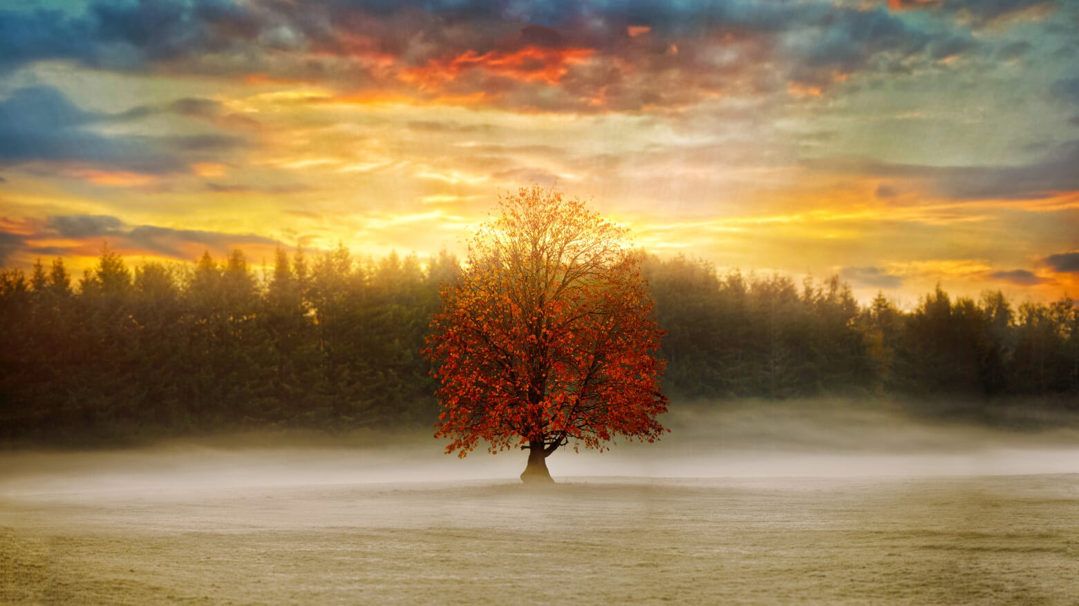
Our Island Tree – Craig Letourneau

Slide 25
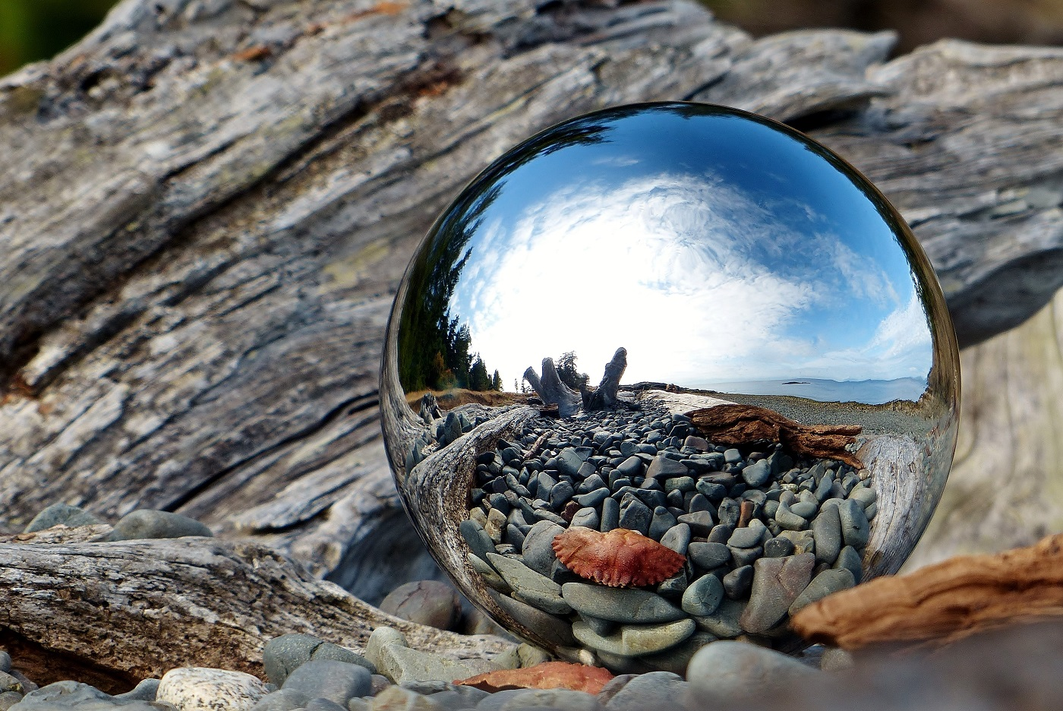
Rocky Shore – Kate Ampersand

Slide 26
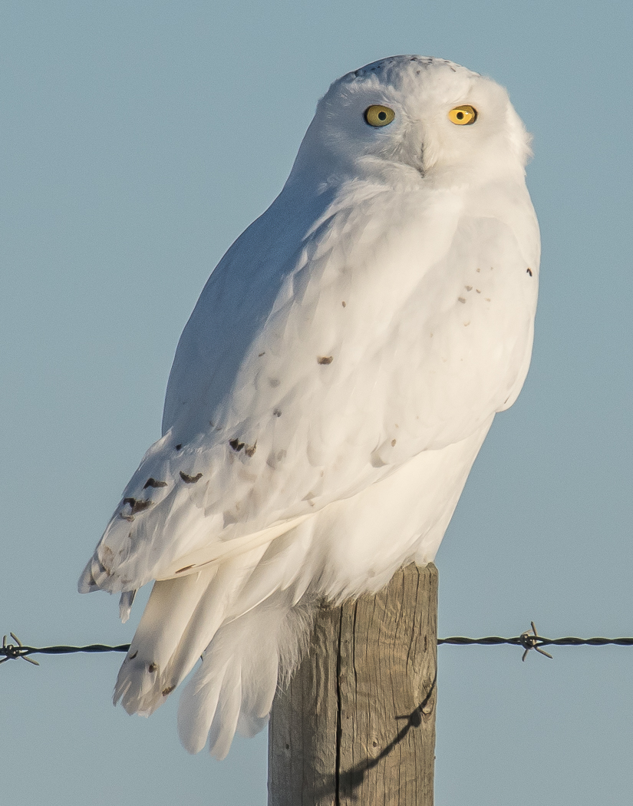
Snowy Owl – Sharon Palmer-Hunter

Slide 27
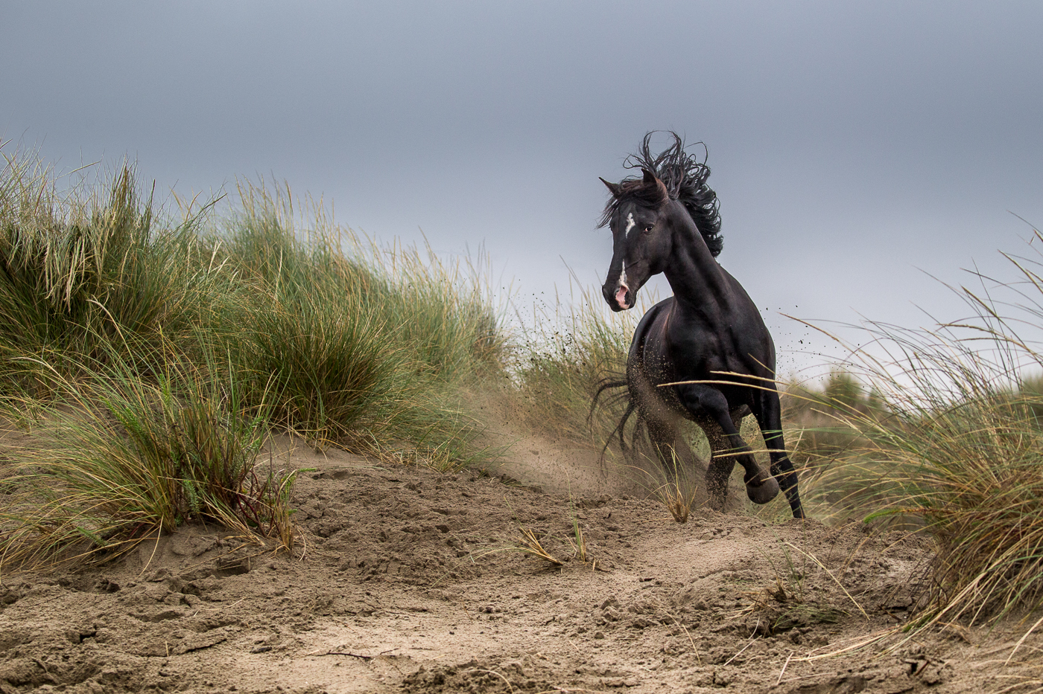
Wild Dance – Leah Grey

Slide 28
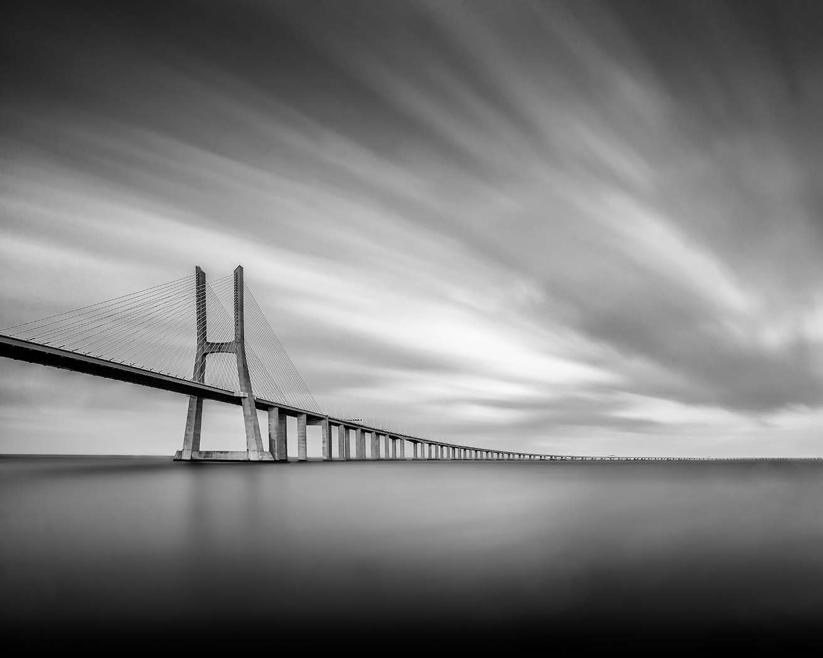
Vasco de Gama – Don Frood

Slide 29
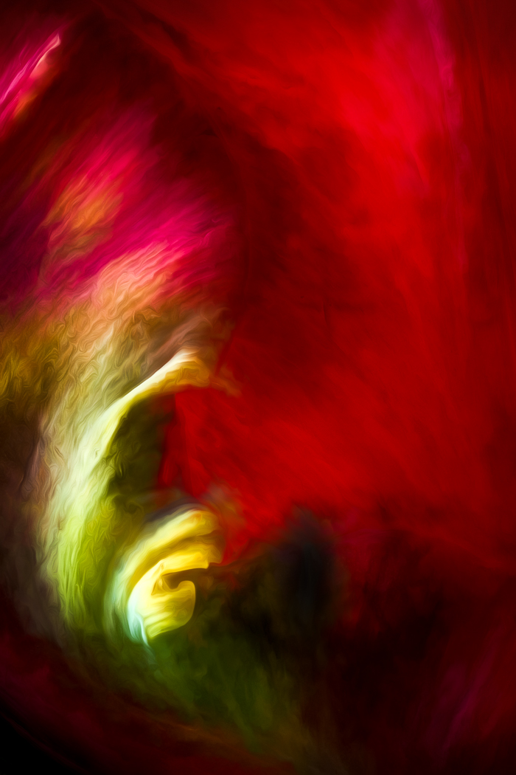
Tulip No. 5 – Judy Hancock-Holland

Slide 30
PHOTO SALON 2020
Capture Life!
Create Art!
Compete for Fun!

Slide 31
For Full Details
www.hcpclub.ca

